Slide 1
DOM105 2019
Session 5

Slide 2
Population parameters and sample statistics
Population refers to all items that have been chosen for study.
A parameter is the characteristic of a population. Eg: 127cm is the mean height of all students in a secondary school, and is a parameter of the population “all students in the school”
Sample is a portion chosen from the population.
A statistic is the characteristic of a sample. Eg: 129cm is the mean height of 100 random students from a secondary school, and is a statistic of the sample of 100 students.

Slide 3
Sampling Theory
Judgment sampling – prior knowledge and opinions are used to determine which items from a population are to be included in a sample. Eg: Determining which geographical areas to carry out a survey.
Probability sampling – all items in the population have a chance of being selected in the sample. Eg: Randomly selecting employees from everyone working in a company for a survey.
Sampling Bias – when samples are chosen that are not truly representative of the population. For example, only polling car owners on their opinion on new traffic laws.

Slide 4
Types of Sampling
Simple Random Sampling With/Without Replacement
Systematic Sampling
Stratified Sampling
Cluster Sampling

Slide 5
Simple Random Sampling With Replacement (SRSWR)
n units to draw from N units
Unit drawn is returned before next draw
All possible choices are equally likely
N^{n} possible samples of size n each
Each sample has probability 1/N^{n}
Same unit may repeat in the same sample
Values of sampled units are random variables.
Independent and identically distributed (IID) random variables

Slide 6
SRS Without Replacement (SRSWOR)
n units to draw at random from N units
Unit once drawn is not returned before drawing the next unit
All possible choices are equally likely
^{N}C_{n} possible samples of size n each
Each sample has probability 1/^{N}C_{n}
Units in a sample are all distinct
Values of sampled units are random variables
Sample units are not independent, but they are identically distributed.

Slide 7
Other types of Sampling
In systematic sampling, elements are selected from the population in uniform intervals, such as after a certain time, or in a certain order.
Systematic sampling inappropriate when elements have sequential patterns.
In stratified sampling, the population divided into homogenous strata, then each strata sampled in proportion to their size (or sampled equally and weighted in proportion to their size)
In cluster sampling, population divided into clusters, each of which are representative of the population, and a random selection of clusters chosen for sampling.
A strata has low variance but differs greatly from other strata, clusters have high variance but are similar to each other.

Slide 8
Steps to designing an experiment
Define the objective of the experiment
Determine what exactly is to be measured, also called the response variable. This is not always same as objective
Decide sampling methods – judgement/probability, systematic/cluster/stratified etc. More than one method may be applied
Decide the size of the sample – larger samples better, smaller samples cheaper
Conduct the experiment under controlled conditions – take steps to eliminate bias and external factors
Analyze the data using statistics or test for hypotheses.

Slide 9
Sampling Distributions
A probability distribution of all possible means of the samples is a distribution of the sample means.
You can also have distributions of the sample median, the sample proportion, or some other statistic of the sample.
The standard deviation of the distribution of a sample statistic is called the standard error of that sample statistic, e.g., the standard error of the sample mean.
Sampling distributions are used to make samples cost-effective by finding the best balance between reducing errors in the sample and reducing cost.

Slide 10
Sampling Distribution of Sample Mean in Simple Random Sampling
Finite Population of size N
Population mean = μ and SD = σ
Random Sample of size n drawn (WR/WOR)
Statistic is Sample Mean
Expectation = μ (both SRSWR and SRSWOR)
SE = σ/√n for SRSWR
SE = (σ/√n).(√ FPC) for SRSWOR
FPC = Finite Population Correction = (N-n)/(N-1)
Limiting Behaviour: As N becomes large with n fixed, both sampling methods are asymptotically equivalent
As a general rule, if n/N<0.05, FPC need not be calculated and can be taken as 1.

Slide 11
The standard error (S.E.) is a measure of how theoretical sample means deviate from the population mean. The larger the sample, the more likely it is that any sample mean is close to the population mean, and so smaller the S.E. In other words, the S.E. is the standard deviation of the sample mean.
This is different from sample standard deviation S, which is the measure of how individual data points deviate from the mean of that single sample.

Slide 12
Drawbacks of Simple Random Sampling
SRS is random, does not take into account existing information and proportions
Ignores typical composition of a population
Example: Suppose the Population is characterized by sex – males and females
N₁ males and N₂ females in the population
N₁ ‘too large’ compared to N₂, say at least 80% are males
SRS will not be representative if the opinions of males and females are to be given equal weightage in the survey.
Surveys such as social surveys that require representation from every part of the population needs other methods.

Slide 13
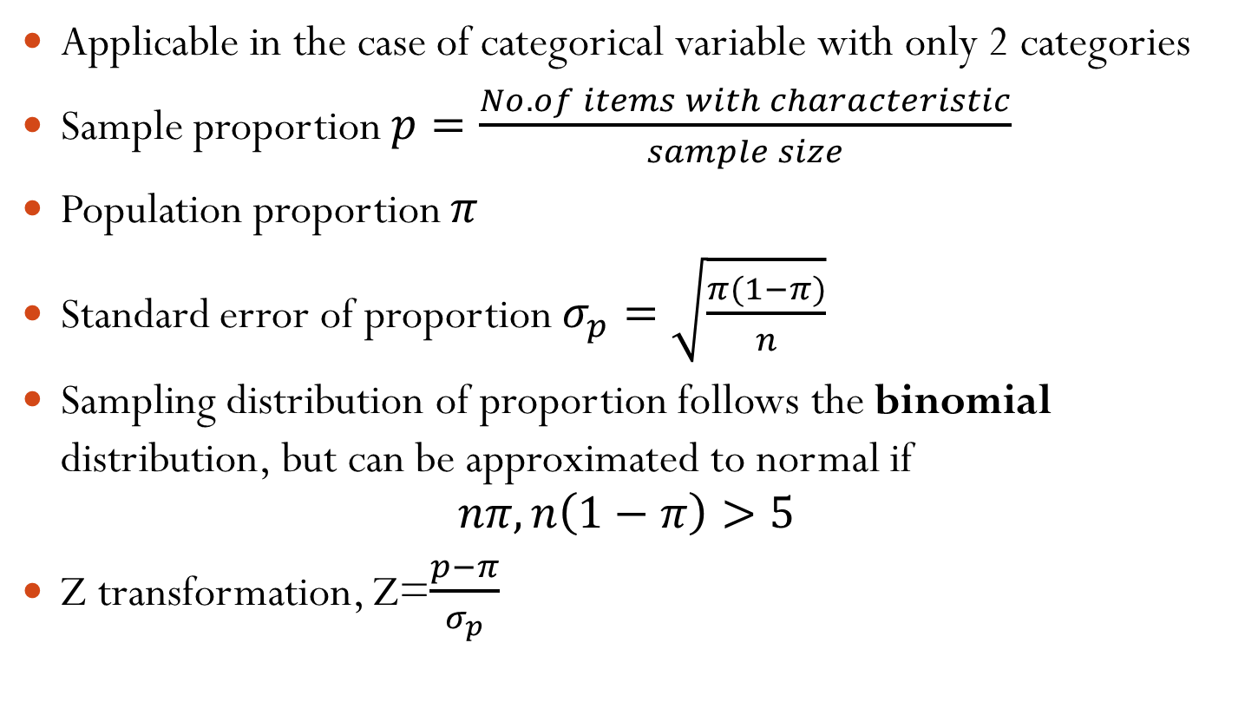
Sampling Distribution of the proportion
Applicable in the case of categorical variable with only 2 categories
Sample proportion $p=\frac{No. of items with characteristic}{sample size}$
Population proportion $π$
Standard error of proportion $σ_{p}=\sqrt{\frac{π(1−π)}{n}}$
Sampling distribution of proportion follows the binomial distribution, but can be approximated to normal if
$$nπ,n\left(1−π\right)>5$$
Z transformation, Z=$\frac{p−π}{σ_{p}}$

Slide 14
Normal and non-normal sampling distributions
Sampling from a normal population
Mean = μ and SD = σ
SRS of size = n (With Replacement)
Statistic = Sample Mean
Expectation = μ; SE = σ/√n
Z = (Sample Mean - μ)/(σ/√n) is N(0, 1)
If sampling is done from a non-normal distribution, distribution of sample mean is no longer normal though formulae for Expectation & SE are still true

Slide 15
Central Limit Theorem
As sample size gets large enough, sampling distribution of the mean is approximately normally distributed even if population has non-normal distribution.
Generally n>30 sufficiently large.
Distribution of sample mean is still normal, but only approximately
Approximation is better and better as n becomes larger and larger
Always true regardless of the underlying distribution from which sampling is done

Slide 16
A confectioner is planning to launch a premium brand of chocolates nationwide. What steps would you take to find out what percentage of the population is both able and willing to buy the new brand?

